Slide 1
Wide Area and Large-Scale Networks
Chapter 12

Slide 2
Learning Objectives
Describe basic concepts associated with wide area networks (WANs)
Identify uses, benefits, and drawbacks of advanced WAN technologies such as ATM, FDDI, SONET, and SMDS
Understand how to use the Internet for private connection using VPNs

Slide 3
Wide Area Network (WAN) Transmission Technologies
WAN spans large geographical area
Composed of individual LANs linked with connection devices like routers or switches
Use leased links from ISP or telco, including
Packet-switching networks
Fiber-optic cable
Microwave transmissions
Satellite links
Cable television coax systems

Slide 4
Wide Area Network (WAN) Transmission Technologies
Consider speed, reliability, cost, and availability when choosing WAN technology
WAN can have different technologies tied together with routers and gateways
Internet is largest WAN and combines all technologies
Three primary technologies are:
Analog
Digital
Packet switching

Slide 5
Analog Connectivity
Public Switched Telephone Network (PSTN) or POTS (plain old telephone system)
Uses analog phone lines and modems, as shown in Figure 12-1
Extremely slow, low quality but economic choice
Inconsistent quality because of circuit-switching
Table 12-1 lists PSTN line types and capabilities

Slide 6
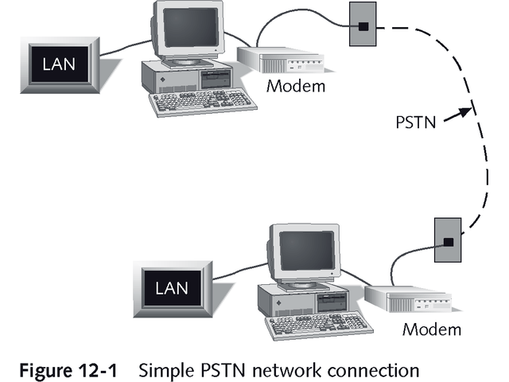
Simple PSTN Network Connection

Slide 7
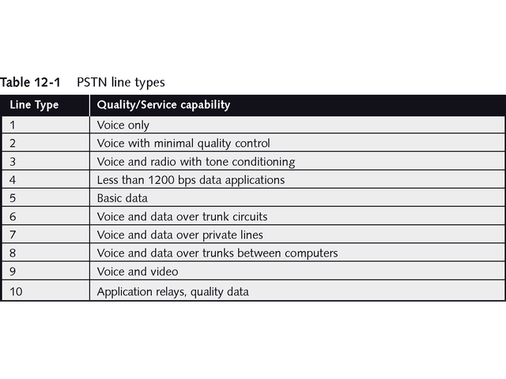
PSTN Line Types

Slide 8
Analog Connectivity
Leased dedicated line improves quality
More expensive but better data transmission
Line conditioning improves dedicated circuits
Results in consistent transmission rate, improved signal quality, and reduced interference and noise
Letters and numbers identify type of conditioning

Slide 9
Analog Connectivity
To decide between dial-up or dedicated PSTN connection, consider a number of factors:
Length of connection time
Cost of service and usage levels
Availability of dedicated circuits, conditioning, or other quality improvements
Assessment of need for 24-hour, seven-day connection

Slide 10
Digital Connectivity
Digital Data Lines (DDS) are direct or point-to-point synchronous links
Transmit at 2.4, 4.8, 9.6, or 56 Kbps with nearly 99% error-free transmission
Four kinds of DDS lines are ISDN, T1, T3,and switched 56K
Uses Channel Service Unit/Data Service Unit (CSU/DSU) instead of modem
See Figure 12-2

Slide 11
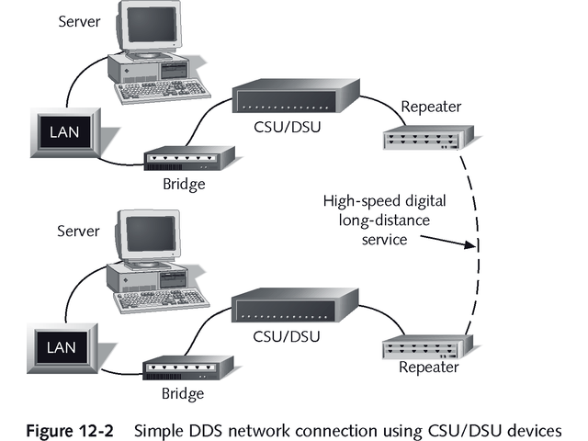
Simple DDS Network Connection Using CSU/DSU Devices

Slide 12
T1
Widely used high-speed digital line with maximum transmission rate of 1.544 Mbps
Uses two wires to transmit full-duplex data signals
One pair transmits; the other receives
24 individual channels, each with rate of 64 Kbps
Fractional T1 is subscription to one or more channels
Table 12-2 shows characteristics of European counterpart E1

Slide 13
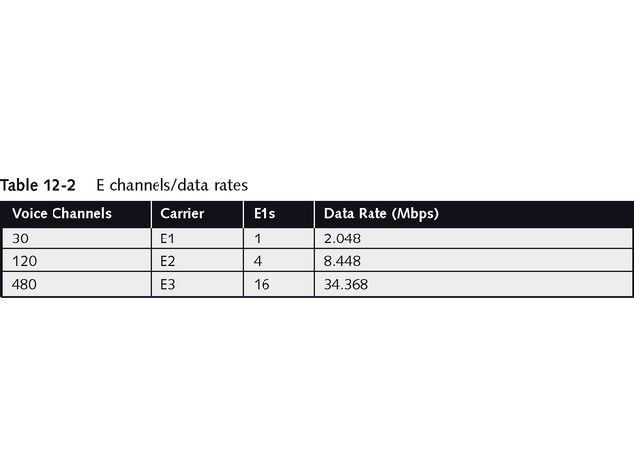
E Channels/Data Rates

Slide 14
Multiplexing
Also called muxing
Several communication streams travel simultaneously over same cable segment
Developed by Bell Lab for telephone lines
Used by T1 to deliver combined transmissions from several sources over single line

Slide 15
Channel Divisions
T1 has 24 separate channels, each supporting 64 Kbps data transmissions
64-Kbps is known as DS-0 transmission rate
Full T1 using all 24 channels is called DS-1
Table 12-3 lists DS rate levels
Multiplexing can increase DS-1 rates up to DS-4 speeds but requires fiber optic cables

Slide 16
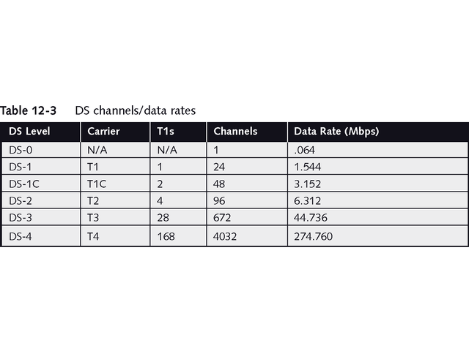
DS Channels/Data Rates

Slide 17
T3
Contains 28 T1 lines or 672 channels
Transmits up to 44,736 Mbps
Fractional T3 lines may be leased in increments of 6 Mbps

Slide 18
Switched 56K
Older digital point-to-point communication link
Pathway is established when customer needs it and ends when transmissions end
Charged on per-minute usage

Slide 19
Integrated Services Digital Network (ISDN)
Single-channel links of 64 Kbps
Reasonable charges based on connect time
Speed is two to four times that of standard POTS modem
Two formats of ISDN
Basic Rate Interface (BRI) – Consists of two B-channels (64 Kbps) for transmission and a D-channel (16 Kbps) for call setup and control
Primary Rate Interface (PRI) – Consists of 23 B-channels and a D-channel

Slide 20
Packet-Switching Networks
Provide fast, efficient, reliable technology
Internet is packet-switching network
Breaks data into small packets
Requires retransmission only of packets with errors
May take different routes to destination where they are reassembled
Figure 12-3 shows packet-switching network

Slide 21
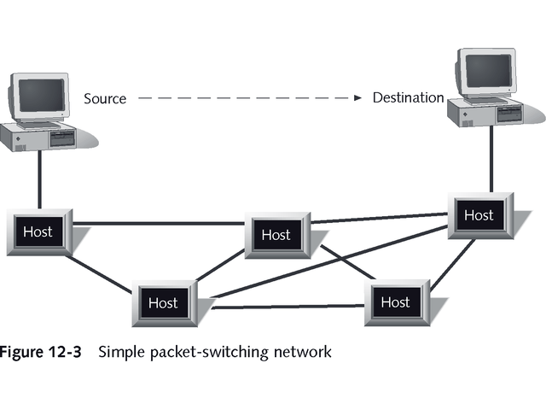
Simple Packet-Switching Network

Slide 22
Virtual Circuits
Provide temporary “dedicated” pathways between two points
Logical sequence of connections rather than actual cable
Two types
Switched virtual circuits (SVCs) are established only when needed and terminated afterwards
Permanent virtual circuits (PVCs) maintain pathways all the time

Slide 23
X.25
Interface between public packet-switching networks and their customers
Connects remote terminals with centralized mainframes
SVC networks creating best pathway upon transmission
Associated with public data networks (PDNs)
Use data terminal equipment (DTE) and data communications equipment (DCE)

Slide 24
X.25
Three methods of connecting X.25 network:
X.25 NIC in computer
Packet assembler/disassembler (PAD)
LAN/WAN X.25 gateway)
Reliable, error free communications
Decreasing in use because of speed limitations

Slide 25
Frame Relay
Point-to-point permanent virtual circuit (PVC)
Offers WAN communications over digital packet-switching network
Faster throughput, but no error checking
Transmission rate of 56 Kbps to 1.544 Mbps
Inexpensive; uses Committed Information Rate (CIR) based on bandwidth allocation of PVC
Users purchase in 64-Kbps CIR increments
Uses pair of CSU/DSUs
Figure 12-4 shows frame relay network

Slide 26
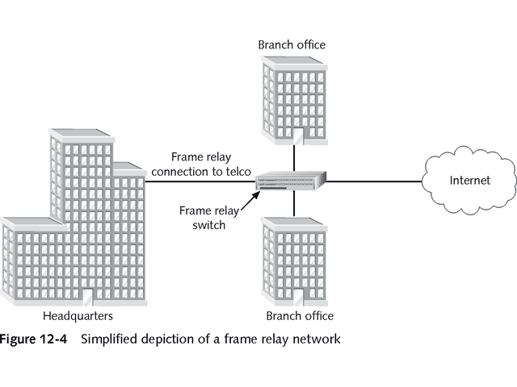
Simplified Depiction of Frame Relay Network

Slide 27
Advanced WAN Technologies
WAN technologies in high demand
Pushing limits of speed and reliability
Several WAN technologies, including:
Asynchronous Transfer Mode (ATM)
Fiber Distributed Data Interface (FDDI)
Synchronous Optical Network (SONET)
Switched Multimegabit Data Service (SMDS)

Slide 28
Asynchronous Transfer Mode (ATM)
High-speed packet-switching technology using digital lines
Uses 53 byte fixed-length protocol data units (PDUs), with one of every 5 bits at Data Link layer used for error checking
Supports transmission rate up to 622 Mbps for fiber-optic cables, but has theoretical maximum of 2.4 Gbps
Can use either SVCs or PVCs between communication points

Slide 29
Fiber Distributed Data Interface (FDDI)
Connects LANs with high-speed dual-ring networks using fiber-optic media
Operates at 100 Mbps
Transmits multiple tokens
Figure 12-5 shows two concentric rings
Provides redundancy in case primary ring fails
Limited by maximum distance of 100 kilometers (62 miles) for any ring
Often used with server clusters or clustered servers that function as single server

Slide 30
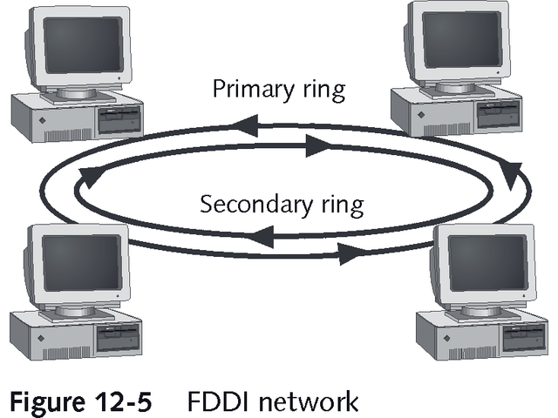
FDDI Network

Slide 31
Synchronous Optical Network (SONET)
Developed by Bell Communications Research to eliminate differences between interface types
WAN technology using fiber-optic media
Transmits voice, data, and video at speeds in multiples of 51.84 Mbps
Provides nearly faultless communications between long-distance carriers
Defines data rate in optical carrier (OC) levels

Slide 32
Switched Multimegabit Data Service (SMDS)
WAN switching technology developed by Bellcore
Offers inexpensive, high-speed network communications of 1.544 to 45 Mbps
Uses 53-byte fixed cell
Provides no error checking

Slide 33
Virtual Private Networks
Temporary or permanent connections across public network
Use special encryption technology
Provides private transmissions using public network

Slide 34
VPNs in Windows Environment
Windows supports Point-to-Point Tunneling Protocol (PPTP)
Windows NT uses Remote Access Service (RAS) to let remote user call server
Windows 2000 uses Routing and Remote Access Service (RRAS)

Slide 35
VPNs in Windows Environment
Layer 2 Tunneling Protocol (L2TP) is more secure VPN protocol introduced with Windows 2000
Supports advanced authentication and encryption
Requires both sides of remote connection use Windows

Slide 36
VPNs in Other Operating System Environments
Linux supports VPN client and server applications
Not compatible with Windows L2TP
More difficult to use; may require a patch to the kernel
VPN masquerade is most popular method for creating VPN connection with Linux

Slide 37
VPNs in Other Operating System Environments
Novell NetWare provides VPN server connections
Able to form VPN WAN by connecting corporate LANs over VPN connections through the Internet
Mac OS version 9 and above support VPN client connections to Windows servers using PPTP or IPSec
Does not support VPN server connections

Slide 38
VPN Operation and Benefits
Separates privacy and encryption functions from other networking operations
Both incoming and outgoing traffic are encrypted
Uses Internet as private dial-up service for users
Can interconnect multiple LANs across Internet

Slide 39
VPN Operation and Benefits
Two basic advantages for dial-up use
Saves money on hardware and system management by eliminating need for multiple modems on RAS server
Saves money on long-distance telephone charges since remote users access RAS server with local call
Greatest benefit of VPN is extending reach of private networks across public ones easily and transparently

Slide 40
Chapter Summary
Linking remote networks and computers creates a WAN across significant distances
From user’s perspective, WAN and LAN are same, with only difference being response time
WANs employ several technologies to establish long-distance connections, including packet-switching networks, fiber-optic cable, microwave transmitters, satellite links, and cable television coax systems

Slide 41
Chapter Summary
Analog WAN connections use PSTN phone lines and offer little reliability or speed
Digital WAN connections offer high-speed connections and much more reliable communications
Digital links range from 56 Kbps to 274 Mbps
CSU/DSU is required to connect to higher-bandwidth digital media, such as frame relay, T1, and T3

Slide 42
Chapter Summary
Low-cost, medium-bandwidth technologies such as DSL and cable modem are taking over SOHO connections
Users always connect from same location and seek better price and bandwidth than analog modems or ISDN can provide
With DSL and cable modem, user does not pay additional costs for CSU/DSU equipment and bandwidth that frame relay, T1, and T3 require

Slide 43
Chapter Summary
T1 and similar lines are not single cables, but collections of pairs of cables
Fractions of these links can be leased
Multiplexing is process of combining and delivering several transmissions on a single cable segment
Packet-switching networks are fast, efficient, and reliable WAN connection technologies

Slide 44
Chapter Summary
Packet switching is process of segmenting data into packets and adding header containing destination and sequence details
Each packet takes unique route to its destination, where it is reassembled into its original form
Virtual circuit is logical pathway between two communication points

Slide 45
Chapter Summary
SVC is temporary circuit that only exists while in use
PVC is permanent pathway that exists even when circuit is not in use
X.25 is WAN technology that offers 64-Kbps network connections and uses error checking
ISDN is WAN technology that offers increments of 64-Kbps connections, most often for SOHO users

Slide 46
Chapter Summary
Frame relay is WAN technology offering transmission rates of 56 Kbps to 1.544 Mbps but no error checking
Unlike other high-speed technologies, frame relay uses switched connection that permits multiple destinations from single frame relay connection
ATM is WAN technology that uses fiber-optic media to support up to 622-Mbps transmission rates

Slide 47
Chapter Summary
ATM uses no error checking and has 53-byte fixed length cell
FDDI is limited-distance linking technology that uses fiber-optic rings to provide 100-Mbps fault-tolerant transmission rates
SONET is WAN technology that interfaces dissimilar long-distance networks
SONET offers transmission speeds in multiples of 51.84 Mbps using fiber-optic media

Slide 48
Chapter Summary
Similar to ATM, SMDS is WAN technology that has 53-byte, fixed-length cell and no error checking
SMDS offers transmission rates of 1.544 Mbps to 45 Mbps
VPN permits public networks such as the Internet to carry dial-up or ongoing encrypted communications between remote users and private networks, or between private LANs
Most of today’s operating systems, including Windows, Linux, and Mac OSs, support VPNs

